Slide 1
Disease Prediction
Using Machine Learning models

Slide 2
The Problem
3.7% of the deaths are due to incorrect prediction of diseases
247.5 Physicians for every 100000 people in US
6.7 Billion Spent on Unnecessary Tests and Treatments in One Year

Slide 3
The Solution
Accurately predicting diseases can improve treatment outcomes
Lowers the stress on healthcare providers
Decreases costs by reducing number of tests performed

Slide 4
Data Wrangling
Data is binary values (0 and 1) for each feature
Target variable - Prognosis is categorical
Dropped columns with Nulls or columns with all 0 values

Slide 5
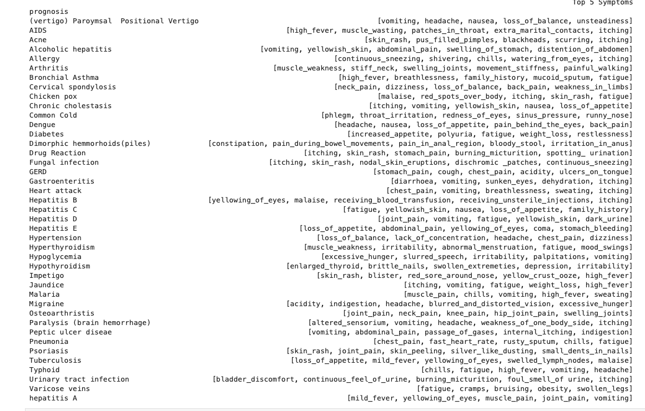
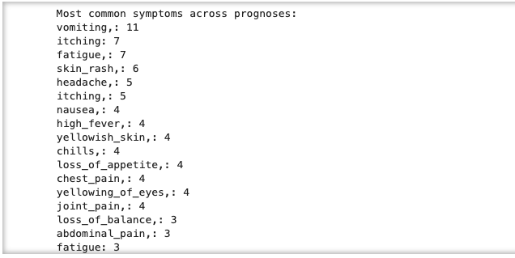
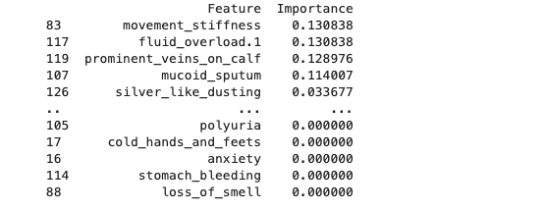
Exploratory Data Analysis

Slide 6
Model Selection
Decision Tree
Random Forest Classifier
XGBoost Classifier

Slide 7
Takeaways
Both RandomForest and XGBoost are highly reliable models for this dataset, with perfect classification performance on the test data.
DecisionTree performed slightly worse but is still a strong model with near-perfect results.
This dataset lacked diversity which could be the reason why the models fit perfectly.
For future work, feature selection techniques could be applied to reduce the dimensionality and improve interpretability.

